Slide 1
KIET Group of Institutions, Ghaziabad
MedXTech : Developing a Patient Condition Prediction System
Group ID : PCSE25-13
Name: Ansh Agrawal Roll No. : 2100290100031 Semester: 8 Department: CSE
Name: Anany Raj Singh Roll No. : 2100290100027 Semester: 8 Department: CSE
Name: Adish Sharma Roll No. : 2100290100011 Semester: 8 Department: CSE
Name of Guide : Dr. Dilkeshwar Pandey
1

Slide 2
KIET Group of Institutions, Ghaziabad
Problem Statement
A significant number of individuals lack access to real-time health monitoring and early detection systems, which are essential for timely medical intervention. Traditional diagnostic approaches often involve lengthy procedures, high costs, and require access to specialized medical infrastructure, making them impractical for large-scale or routine health assessments. These limitations hinder early diagnosis and delay critical treatment, especially in remote or underserved areas. There is a growing need for a reliable, cost-effective, and user-friendly predictive tool that can instantly analyze vital health parameters and provide accurate health risk assessments, enabling proactive care and improving health outcomes.

Slide 3
KIET Group of Institutions, Ghaziabad
Project Objectives
Our 4 Major Objectives of our project are:-
Develop a machine learning-based model for predicting a patient's health condition.
Provide a clean and intuitive user interface for data input and health assessment.
Integrate clinically relevant parameters to enhance prediction reliability.
Facilitate remote healthcare monitoring.

Slide 4
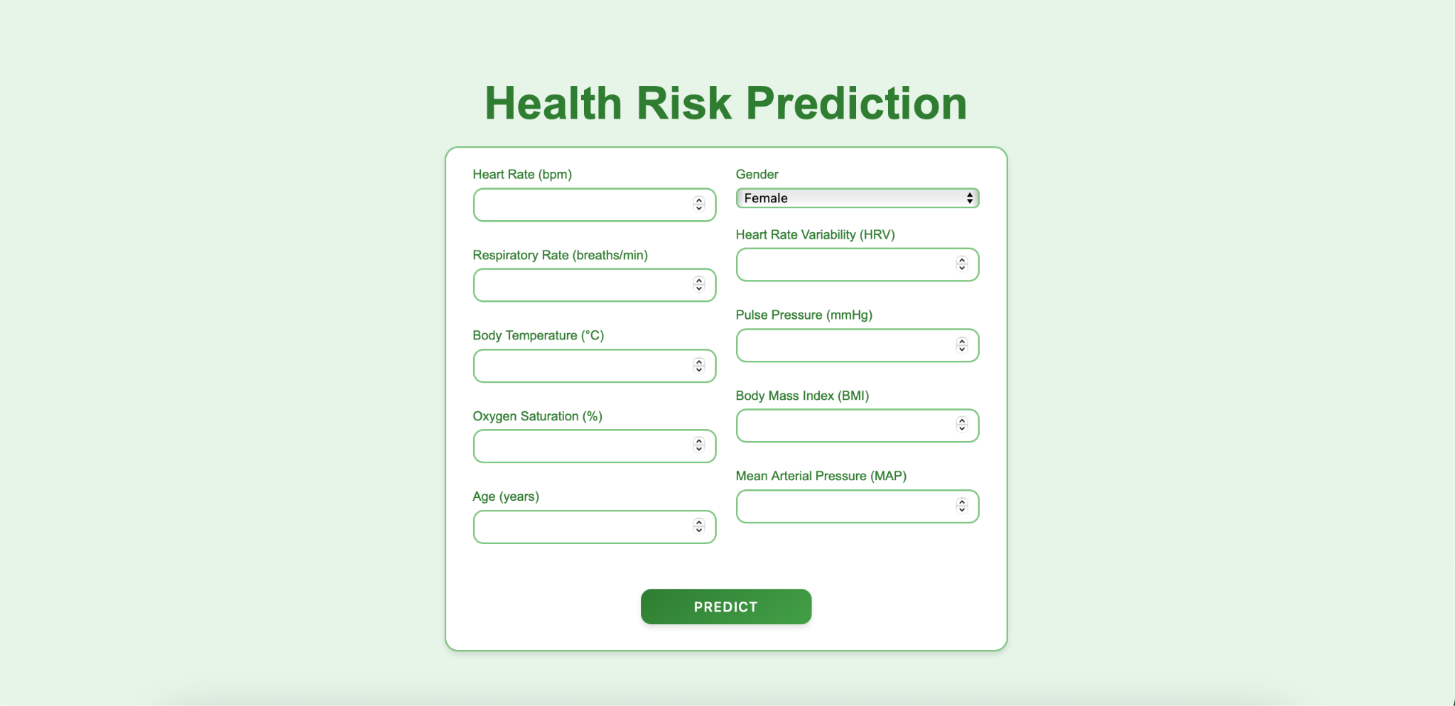
KIET Group of Institutions, Ghaziabad
User Interface

Slide 5
KIET Group of Institutions, Ghaziabad
Input Parameters
Physiological inputs include:
Heart Rate (bpm)
Respiratory Rate (breaths/min)
Body Temperature (°C)
Oxygen Saturation (%)
Age (years), Gender
Heart Rate Variability (HRV)
Pulse Pressure (mmHg)
Body Mass Index (BMI)
Mean Arterial Pressure (MAP)
Each parameter plays a significant role in predicting a person's health status.

Slide 6
KIET Group of Institutions, Ghaziabad
Technology Used
Frontend: HTML/CSS with Flask framework for web deployment.
Backend: Python with integrated ML models.
ML Algorithms: Voting Classifier combining Logistic Regression, Decision tree, SVM, and Naïve Bayes.

Slide 7
KIET Group of Institutions, Ghaziabad
Preprocessing & ML
Input data is normalized and validated before processing.
Feature engineering improves signal clarity.
Voting Classifier ensures robustness and improved accuracy across patient types.
Model trained on balanced datasets for unbiased predictions.

Slide 8
KIET Group of Institutions, Ghaziabad
Application Domain
Field: Healthcare / Clinical Decision Support
Use Cases:
Remote health screening
Emergency response systems
Home-based care programs
Preventive healthcare solutions

Slide 9
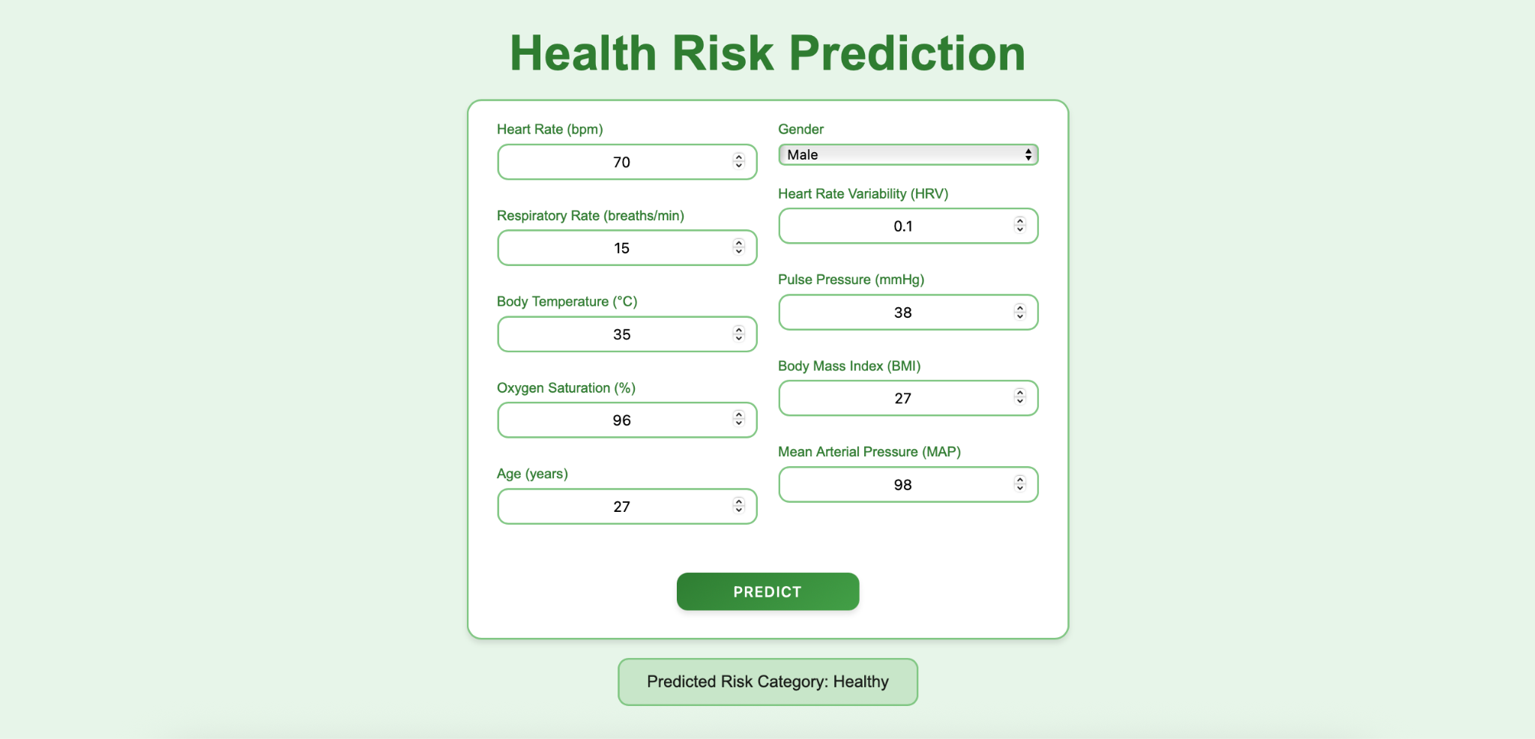
KIET Group of Institutions, Ghaziabad
Result

Slide 10
KIET Group of Institutions, Ghaziabad
Future Scope
Addition of wearable device integration for continuous monitoring.
Mobile app with real-time alerts and health logs.
Integration with hospital EHRs and telemedicine platforms.
Use of deep learning for enhanced performance.

Slide 11
KIET Group of Institutions, Ghaziabad
Conclusion
MedXTech provides a practical, scalable, and AI-driven solution for health risk prediction.
Promotes timely intervention and better patient outcomes.
A step toward personalized and preventive healthcare delivery.

Slide 12
KIET Group of Institutions, Ghaziabad
Thank You

